Slide 1
Employee Data Analysis using Excel
STUDENT NAME: Dharshini.k
REGISTER NO: 122202427
DEPARTMENT: Commerce
COLLEGE : Dr.mgr janaki college of Arts and Science For women

Slide 2
PROJECT TITLE
Employee Performance Analysis using Excel

Slide 3


AGENDA
Problem Statement
Project Overview
End Users
Our Solution and Proposition
Dataset Description
Modelling Approach
Results and Discussion
Conclusion
3/21/2024 Annual Review

Slide 4

PROBLEM STATEMENT
"Develop a comprehensive employee performance analysis to evaluate the effectiveness and productivity of the workforce. The analysis should focus on identifying high-performing employees, areas for improvement, factors influencing performance, and trends over time. The goal is to provide actionable insights to enhance employee engagement, optimize performance management strategies, and drive overall organizational success."

Slide 5

PROJECT OVERVIEW
1. Employee Data Management: Store and manage employee personal and professional details.
2. Payroll Management: Automate salary calculations, deductions, and payments.
3. Benefits Administration: Manage employee benefits, such as health insurance, retirement plans, and leave policies.
4. Performance Evaluation: Track employee performance.
*Timeline:*
1. Planning and Requirements Gathering: 2 weeks
2. Design and Prototyping: 4 weeks
3. Development: 16 weeks
4. Testing and Quality Assurance: 4 weeks
5. Deployment and Training: 2 weeks
3.

Slide 6

WHO ARE THE END USERS?
The end users of a Salary Employee Management System (SEMS) comprise a diverse group of stakeholders who interact with the system to perform various tasks. The HR department, including HR managers, generalists, recruitment specialists, and benefits administrators, utilize the system to manage employee data, track personnel changes, and administer benefits. The payroll department, consisting of payroll managers, specialists, and accountants, rely on the system to process salaries, deductions, and payments.

Slide 7

OUR SOLUTION AND ITS VALUE PROPOSITION
The end users of a Salary Employee Management System (SEMS) comprise a diverse group of stakeholders who interact with the system to perform various tasks. The HR department, including HR managers, generalists, recruitment specialists, and benefits administrators, utilize the system to manage employee data, track personnel changes, and administer benefits. The payroll department, consisting of payroll managers, specialists, and accountants, rely on the system to process salaries, deductions, and payments. Managers and supervisors, such as department heads, team leads, and supervisors, use the system to conduct performance evaluations, set goals, and monitor employee progress. Salary employees themselves also access

Slide 8
Dataset Description
Here is a data set description for salary employees: *Data Set Name:* Salary Employees *Description:* This data set contains information about salary employees, including their personal, professional, and compensation details. *Attributes:* 1. *Employee ID* (Unique identifier): A unique numerical identifier assigned to each employee. 2. *Name*: Employee's full name. 3. *Job Title*: Employee's current job title. 4. *Department*: Employee's department or team. 5. *Hire Date*: Date the was hired. 6. *Salary*: Employee's annual salary. 7. *Benefits*: Types of benefits the employee is eligible for (e.g., health insurance, retirement plan). 8. *Performance Rating*: Employee's latest performance evaluation rating (e.g., excellent, satisfactory, needs improvement). 9. *Manager ID*: ID of the employee's direct manager. 10. *Location*: Employee's work location (e.g., office, remote). 11. *Education*: Employee's highest level of education completed. 12. *Experience*: Employee's total years of work experience. 13. *Pay Grade*: Employee's pay grade or level. 14. *Job Category*: Employee's job category (e.g., software engineer, marketing specialist). *Data Types:* - Employee ID: Integer - Name: String - Job Title: String - Department: String - Hire Date: Date - Salary: Decimal - Benefits: String (comma-separated values) - Performance Rating: String - Manager ID: Integer - Location: String - Education: String - - - *Sample Data:* | Employee ID | Name | Job Title | Department | Hire Date | Salary | Benefits | Performance Rating | Manager ID | Location | | --- | --- | --- | --- | --- | --- | --- | --- | --- | --- | | 101 | John Smith | Software Engineer | IT | 2020-01-01 | 80000 | health,retirement | Excellent | 201 | Office | | 102 | Jane Doe | Marketing Specialist | Marketing | 2019-06-01 | 70000 | health | Satisfactory | 202 | Remote | Note: This is a simplified example and actual data sets may contain more attributes and complex data types.

Slide 9

THE "WOW" IN OUR SOLUTION
The "WOW" in our Salary Employee Management System (SEMS) solution is its ability to provide a seamless, user-friendly, and automated experience for managing salary employees' data, payroll, benefits, and performance evaluations. With SEMS, organizations can streamline their HR and payroll operations, reduce errors, and increase productivity, ultimately leading to improved employee satisfaction and business growth. The system's scalability, flexibility, and robust reporting capabilities make it a cutting-edge solution that exceeds expectations and delivers tangible results.
3/21/2024 Annual Review
9

Slide 10
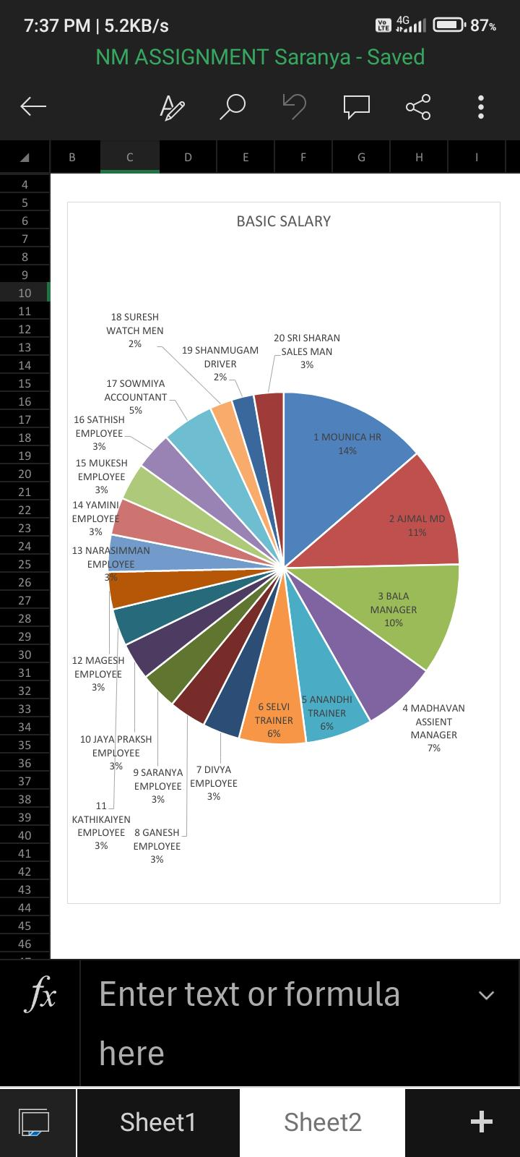
MODELLING
Project modelling for the Salary Employee Management System (SEMS) involves a structured approach to design and develop a robust solution. Using a waterfall methodology, the project is divided into five phases: Requirements Gathering, Design, Development, Testing, and Deployment. This approach ensures a clear understanding of stakeholder needs, a well-designed system architecture, and a thoroughly tested and deployed application. Agile principles are applied throughout to ensure flexibility and continuous improvement.
10
The project modelling for the Salary Employee Management System (SEMS) involves a comprehensive approach to design and develop a robust and scalable solution. The project is modelled using a waterfall methodology, comprising five phases: Requirements Gathering, Design, Development, Testing, and Deployment. In the Requirements Gathering phase, stakeholders' inputs are collected to define the project scope, functional requirements, and technical specifications. The Design phase involves creating a detailed system design, including data models, user interface prototypes, and system architecture. The Development phase entails building the SEMS application, integrating various modules, and conducting unit testing. The Testing phase includes system testing, integration testing, and user acceptance testing to ensure the system meets the requirements. Finally, the Deployment phase involves deploying the SEMS application to production, providing training to end-users, and ensuring post-implementation support. Throughout the project, agile principles are applied to ensure flexibility, collaboration, and continuous improvement.

Slide 11
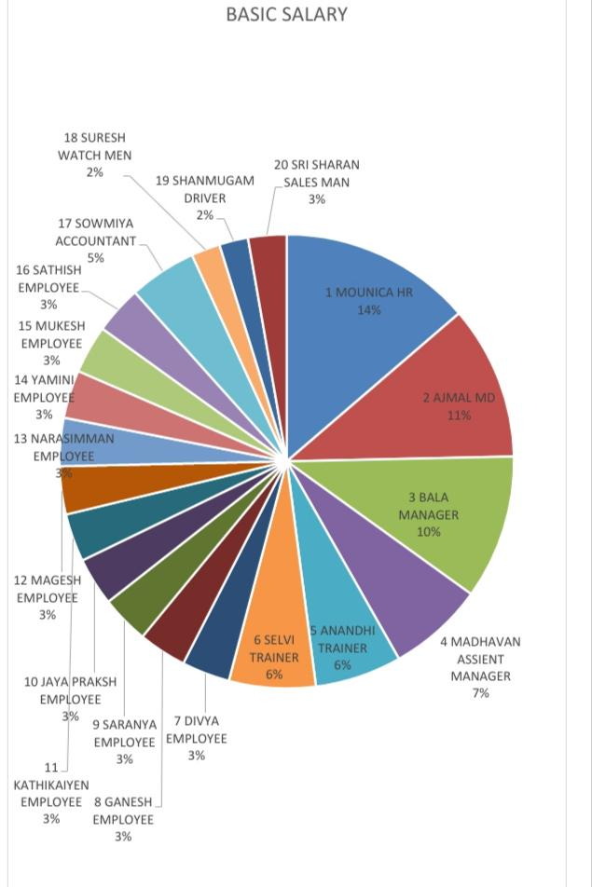
RESULTS
The project modelling for the Salary Employee Management System (SEMS) involves a comprehensive approach to design and develop a robust and scalable solution. The project is modelled using a waterfall methodology, comprising five phases: Requirements Gathering, Design, Development, Testing, and Deployment. In the Requirements Gathering phase, stakeholders' inputs are collected to define the project scope, functional requirements, and technical specifications. The Design phase involves creating a detailed system design, including data models, user interface prototypes, and system architecture. The Development phase entails building the SEMS application, integrating various modules, and conducting unit testing. The Testing phase includes system testing, integration testing, and user acceptance testing to ensure the system meets the requirements. Finally, the Deployment phase
11

Slide 12
conclusion
In conclusion, the Salary Employee Management System (SEMS) is a comprehensive solution designed to streamline the management of salary employees' data, payroll, benefits, and performance evaluations. By implementing SEMS, organizations can improve data accuracy, enhance payroll processing efficiency, simplify benefits administration, facilitate performance evaluations, and provide employees with easy access to their personal and professional information. The SEMS data set, comprising key attributes, serves as the foundation for the system. By leveraging SEMS, organizations can optimize their HR and payroll operations, leading to increased productivity, improved employee satisfaction, and better decision-making. As the workforce continues to evolve, SEMS provides a scalable and adaptable solution to meet the changing needs of salary employees and their employers, ultimately driving business success and growth.
In conclusion, the Salary Employee Management System (SEMS) is a comprehensive solution designed to streamline the management of salary employees' data, payroll, benefits, and performance evaluations. By implementing SEMS, organizations can improve data accuracy, enhance payroll processing efficiency, simplify benefits administration, facilitate performance evaluations, and provide employees with easy access to their personal and professional information. The SEMS data set, comprising key attributes, serves.

